Slide 1
Patient-Reported Outcomes and Waiting for Elective Surgery: Preliminary Findings
Jason M. Sutherland
Centre for Health Services and Policy Research
University of British Columbia
The Taming of the Queue
Appropriateness and Accountability
April 4, 2014

Slide 2
Disclosure
The research presented today is funded by:
Canadian Institute for Health Research (CIHR)
Vancouver Coastal Health Authority (in-kind)
Approved by:
University of British Columbia Behavioural Research Ethics Board
Vancouver Coastal Health Authority Privacy Office

Slide 3
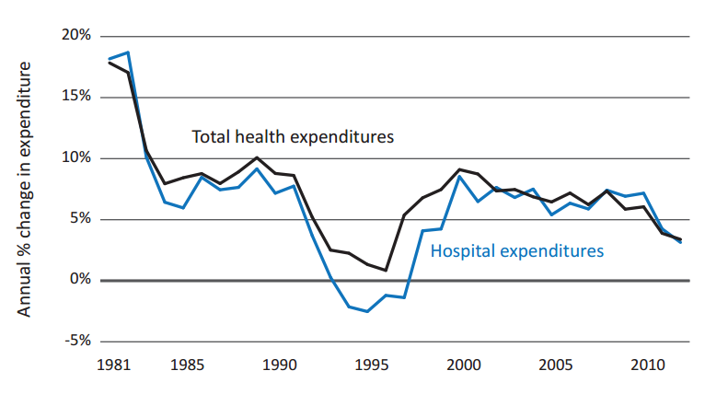
Spending Annual % change in total health and hospital spending, 1981-2012
Source: CIHI, CMS National Health Expenditure Historical Data
Notes:
http://www.cihi.ca/cihi-ext-portal/internet/en/applicationfull/spending+and+health+workforce/spending/cihi021698

Slide 4
How are we doing?
Commonwealth Fund 2013

Slide 5
What is missing?
Collect and measure patient-reported outcomes
Completed by patients
Standardized, validated questionnaires
Measure self-perceived quality of life, functional well-being and health status
Generic or condition-specific

Slide 6
Self-reported health on the wait list Methods
Elective surgery
Measure patient’s reported outcomes prospectively
Evaluate changes in patients’ health over time

Slide 7
Where do we collect PROs?

Slide 8
Self-reported health on the wait list Methods
7 specialties; 6 hospitals in metro Vancouver region
Response Rate:
Entering wait list: 45 %
Just before surgery: 68 %

Slide 9
Self-reported health status EQ-5D
Five domains:
Mobility
Self-care
Usual activities
Pain / discomfort
Anxiety / depression
AND
A ranking of overall health status
Notes:
Each domain is a rank out of 3

Slide 10
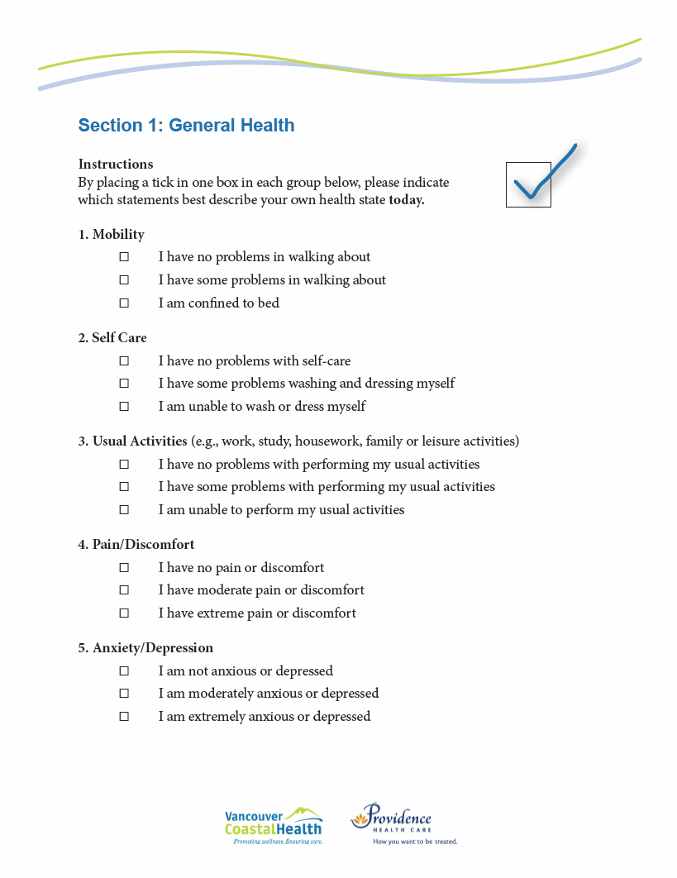
Self-reported health EQ-5D
Notes:
Each domain is a rank out of 10

Slide 11
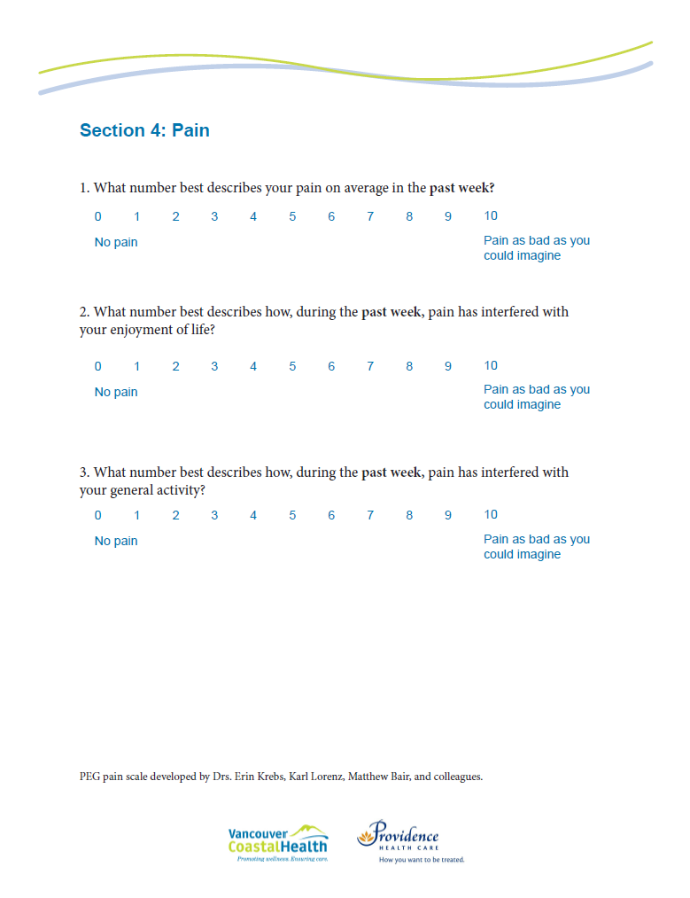
Self-reported pain
Three domains:
Intensity of pain
Pain interference in enjoyment of life
Pain interference with general activity
Notes:
Each domain is a rank out of 10

Slide 12
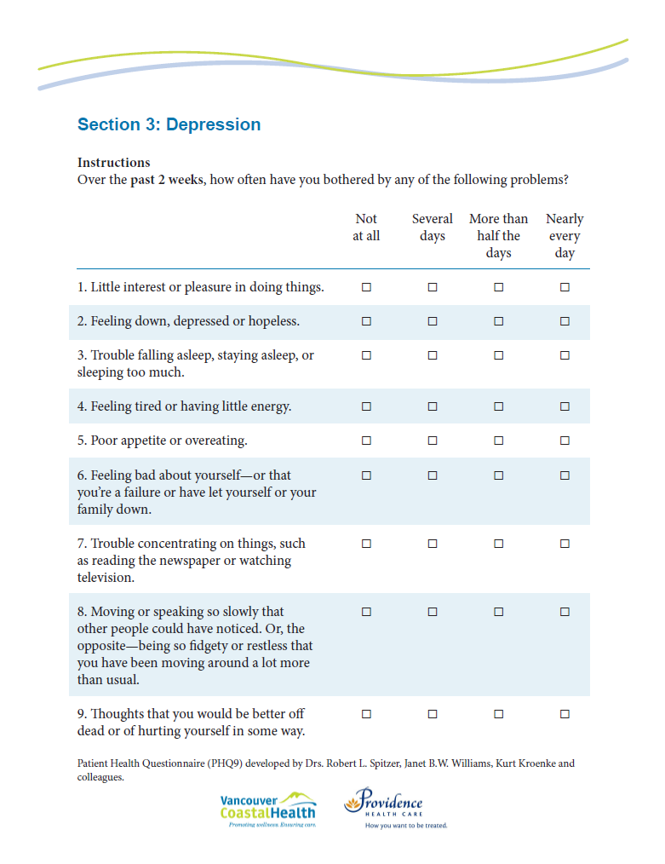
Self-reported depression
Two domains:
Symptoms
Functional impairment

Slide 13
Self-reported health
What does a patient’s self-reported health tell us at the start of their wait time?
Aspects of health are very good:
Usual activities
Function and Mobility
Largest potential for improving patient’s health:
Anxiety / Depression
Pain

Slide 14
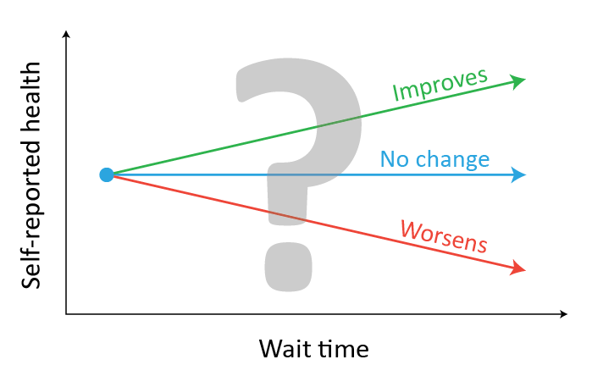
The wait and self-reported health

Slide 15
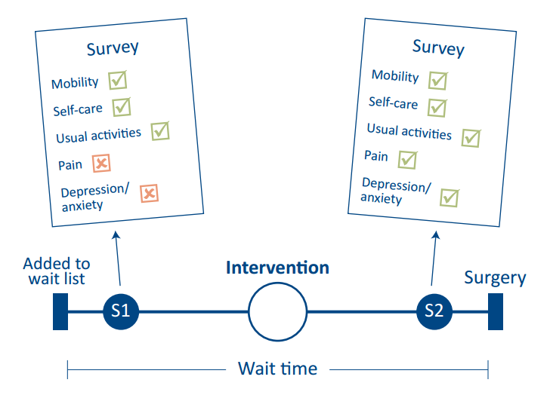
Self-reported health
What does patient’s change in self-reported health over the wait time tell us?

Slide 16
Advancing world-class health services and policy research and training on issues that matter to Canadians www.patientreportedoutcomes.ca www.chspr.ubc.ca @CHSPR

